Slide 1
Image Deblurring and Super-Resolution using Deep Learning
JOSEPH J VALAVI

Slide 2
INTRODUCTION
Blur is an unsharp image area caused by camera or subject movement, inaccurate focusing, or the use of an aperture that gives shallow depth of field.
It is also considered as a random noise.
This causes the resolution of the picture to reduce making the outline and the features of the image unclear.
Deep learning can be applied to enhance the image for deblurring the image and upscaling the resolution for capturing the features of the image.
Auto encoders are used for deblurring the image and super resolution convolutional network(SRCNN) is used for upscaling the image resolution.

Slide 3
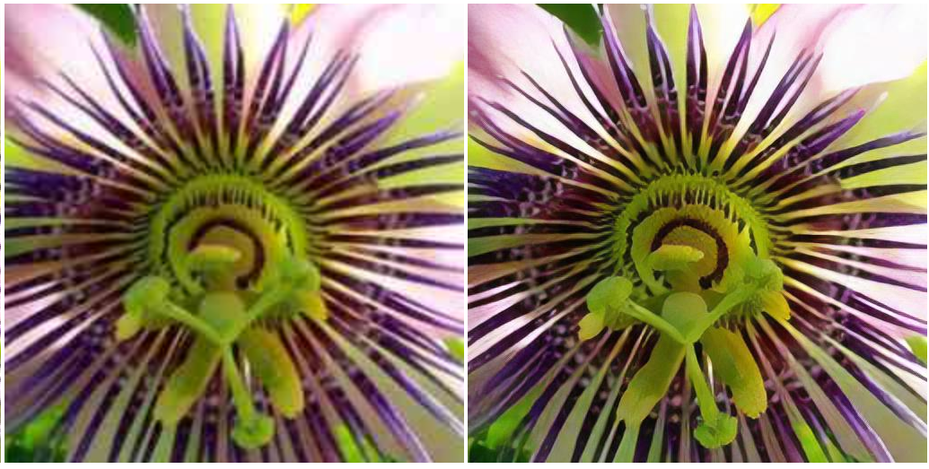
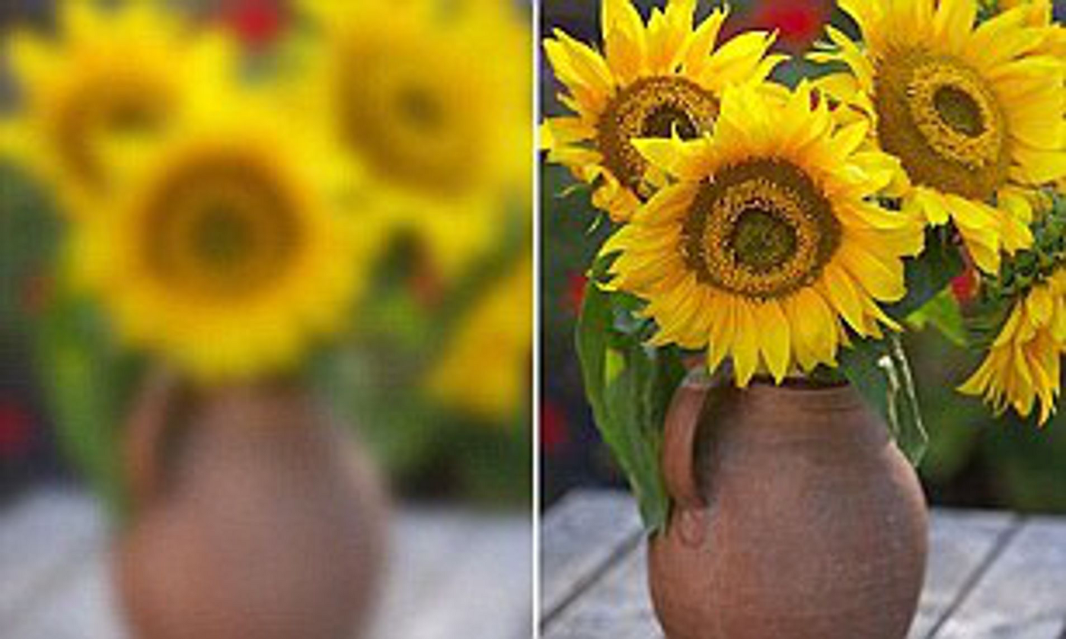
Image deblurring image super resolution

Slide 4
RELEVANCE OF THE TOPIC
Image deblurring is a process, which is used to make pictures sharp and useful.
Image deblurring have wide applications from consumer photography, e.g., remove motion blur due to camera shake, to radar imaging and satellite imaging.
In the medical field this super resolution and deblurring of endoscopic images ,MRI scan images and used in various medical imaging process.
The need for high resolution is common in computer vision applications for better performance in pattern recognition and analysis of images

Slide 5
EXISTING SYSTEM
The existing system uses the image processing filters and methods to remove the noise present in image.
This method of removing blur noise has least performance.
Super resolution is not achieved by this convectional method.
PROPOSED SYSTEM
The proposed system is deep learning model for image deblurring and super resolution
Which learns from the data and has improved performance than using image processing
Tools.

Slide 6

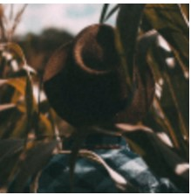
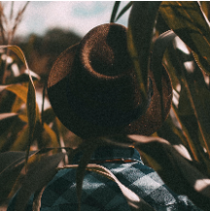
DESCRIPTION OF THE PROJECT
Image deblurring is a recovering process that recovers a sharp latent image from a blurred image, which is caused by camera shake or object motion. It has widely attracted attention in image processing and computer vision fields.
Deep learning techniques are used for image restoration purpose ,auto encoders for image deblurring and convolutional neural networks for image super resolution.
By increasing the image resolution the patterns and features of the images is more accurately extracted.
This image restoration technique is widely used in satellite images , medical imaging, remote sensing ,and photographic applications.
Blurred input image deblurred low resolution image super resolution image

Slide 7
SYSTEM DESIGN
Blurred input image
Image deblurring
Auto Encoder
Deblurred Low resolution output
image
High Resolution output image
SRCNN

Slide 8
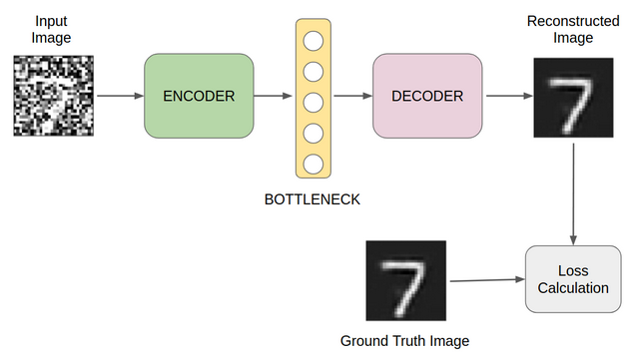
ARCHITECTURE
IMAGE DEBLURRING AUTO ENCODER
Auto encoder is uses for image deblurring, which takes blurred image as input and gives a deblurred image .
The encoder takes the input, processes it, extracts features, and then stores the data in the hidden layer. A decoder does the opposite of what an encoder does. It takes the data from the hidden layer and then recreates an image using the same.

Slide 9
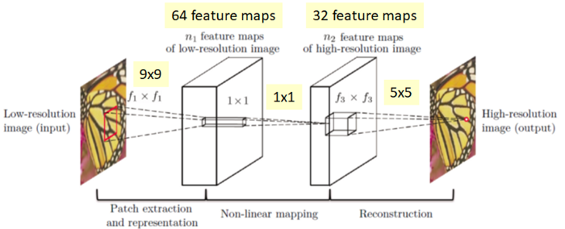
Image super resolution model (SRCNN)
The Super resolution is the process of upscaling and or improving the details within an image.
a low resolution image is taken as an input and the same image is upscaled to a higher resolution.
PATCH EXTRACTION AND REPRESENTATION: This operation extracts (overlapping) patches from the low-resolution image and represents each patch as a high-dimensional vector.
NON-LINEAR MAPPING: This operation nonlinearly maps each high-dimensional vector onto another high-dimensional vector.
RECONSTRUCTION: This operation aggregates the above high-resolution patchwise representations to generate the final high-resolution image.

Slide 10
MODULES
IMAGE DEBLURRING MODULE
An Auto encoder for image deblurring.
IMAGE SUPER RESOLUTION
Convolution neural network (SRCNN )for image super resolution.
USER INTERFACE
Web app using streamlit for inputing and processing the blurred or low resolution images.

Slide 11
INPUT AND OUTPUT
INPUT
Deblurred low resolution image
OUTPUT
Deblurred high resolution image
TOOLS AND FRAME WORKS
Google colab
Spyder
Streamlit API
PROGRAMING LANGUAGE
Python
Html,css

Slide 12
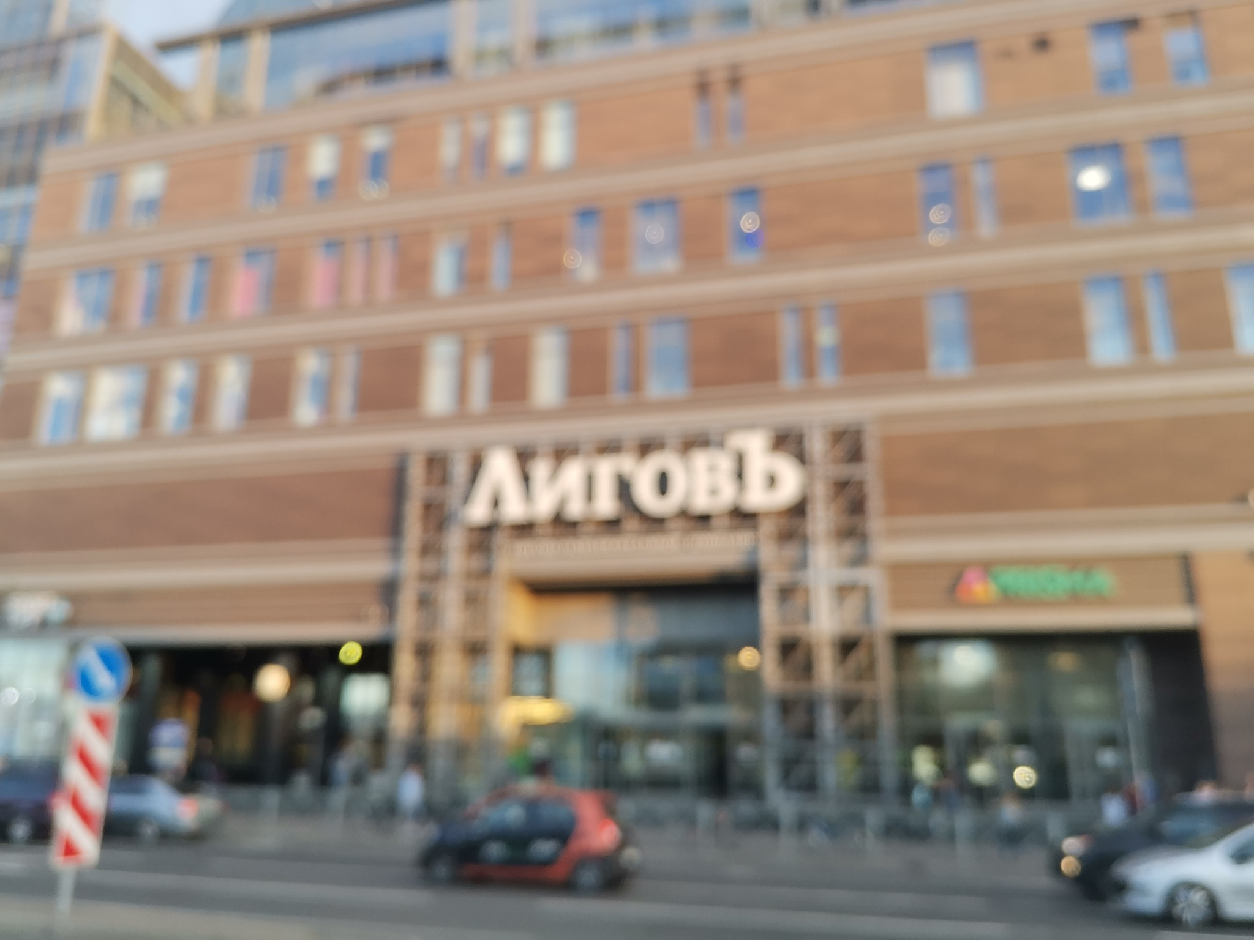
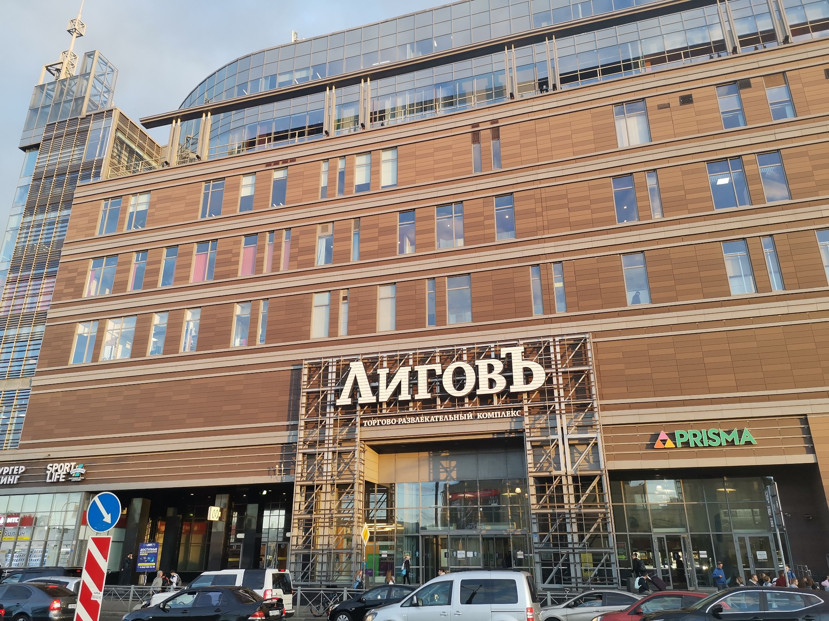
DATASETS
DATASET FOR IMAGE DEBLURING MODEL
Dataset consists of 2 set images which are blurred images and deblurred images.
Data set consists of 350 images for each set.

Slide 13
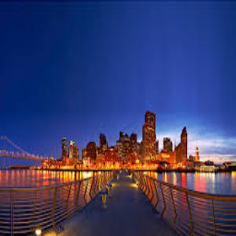

DATASETS
DATA SET OF IMAGE SUPER RESOLUTION
It consists of 2 set of images high resolution and low resolution images .
Each set consists of 850 images each

Slide 14
THANK YOU

Slide 15
